Slide 1


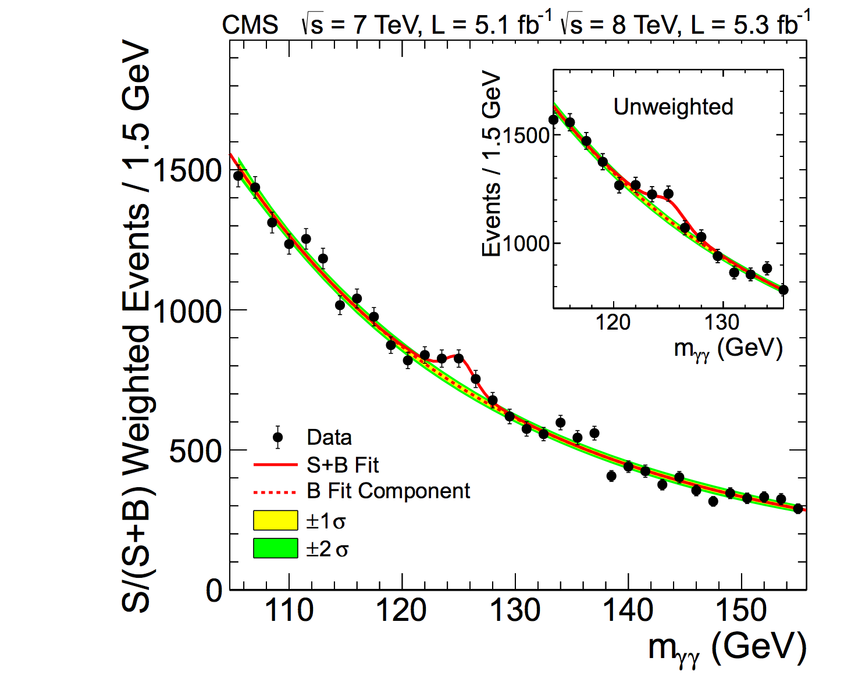
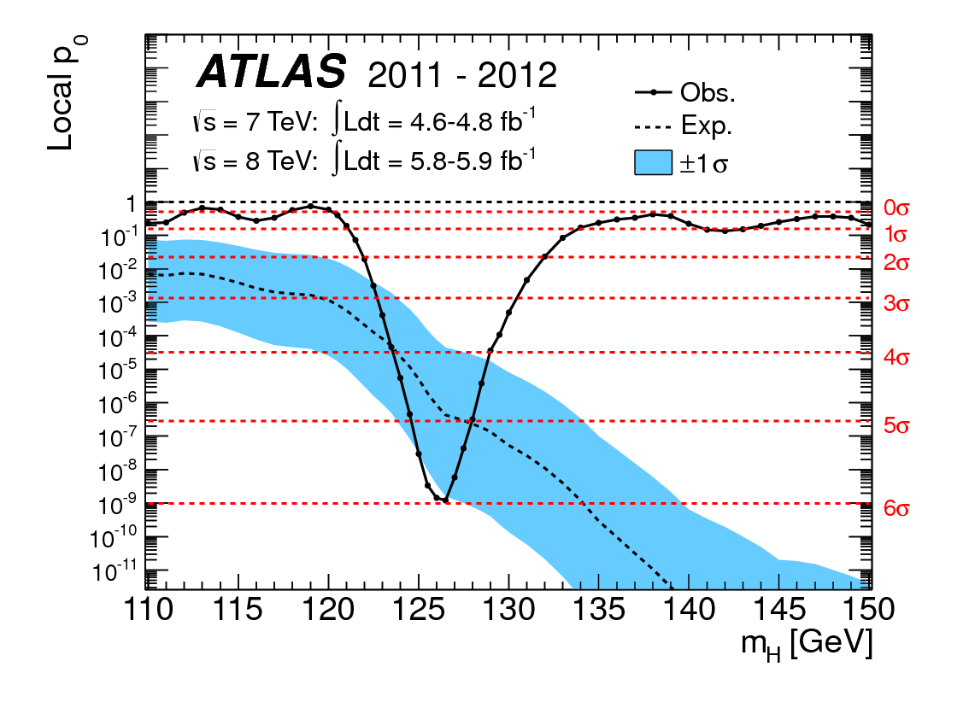
Introduction to Monte-Carlo Event Generators
Sahal Yacoob
University of Kwazulu-Natal

Slide 2
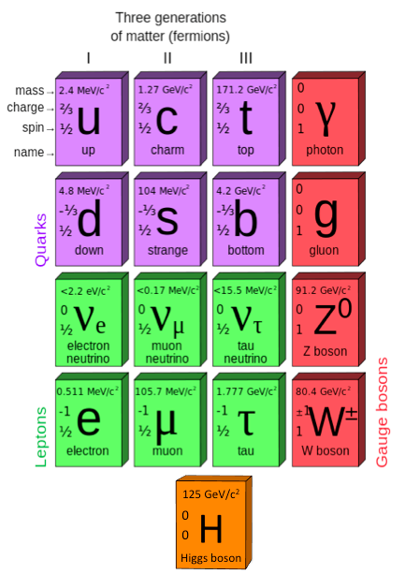
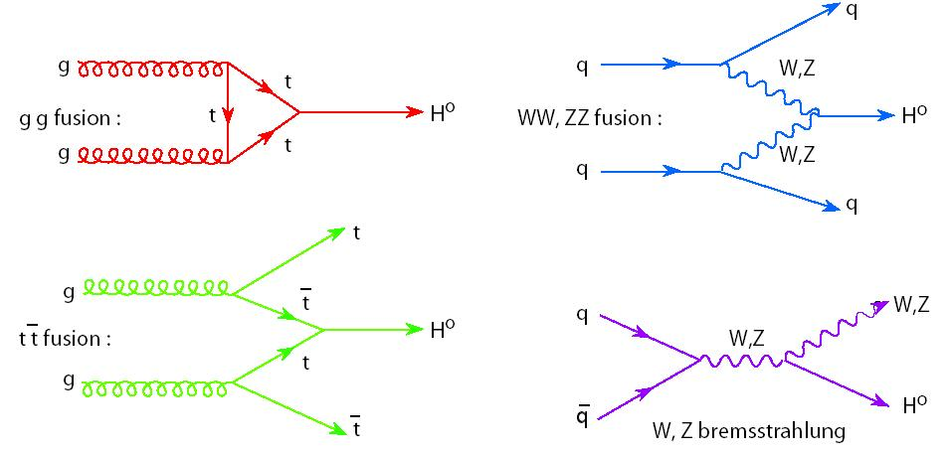
Elementary particles of the standard model

Slide 3
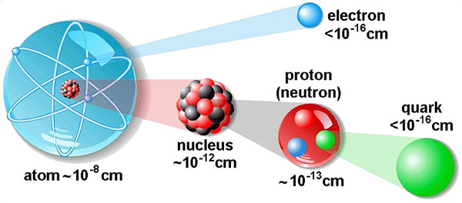
Atomic Sub-structure

Slide 4
Collision event video
(movie)

Slide 5
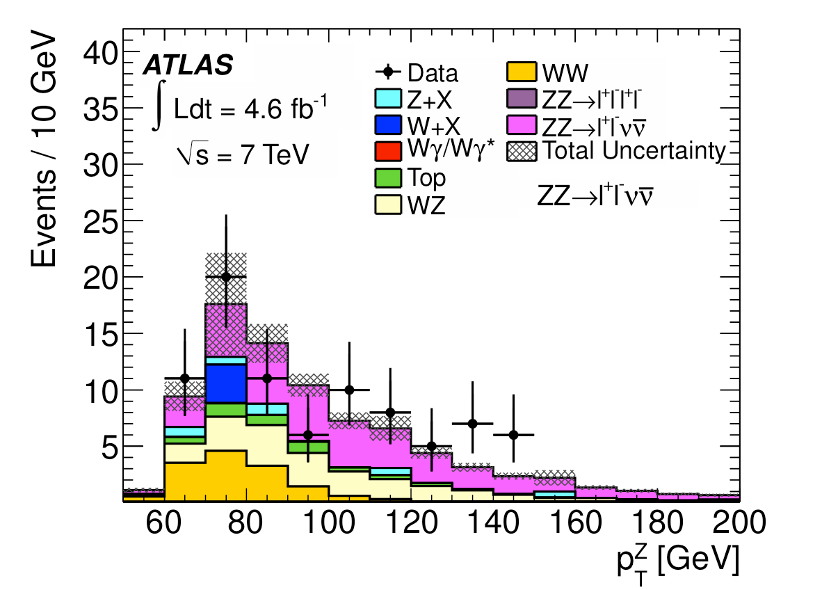
M.C. distributions are important for comparison to Data

Slide 6
A Monte-Carlo event in principle
Answers the question:
  Given a particular initial state (two in coming protons, and a particular final state (2 electrons with energy greater than a certain value for example) what is the probability that the transition between the initial and final states took place via the chosen process.
  The total probability is the sum over the contributions from all possible processes

Slide 7
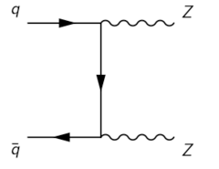
Factorisation – Matrix element
The probability for the ‘process’, or ‘Hard Scatter` to occur can be calculated in terms of the momenta of the incoming and outgoing elementary particles.

Slide 8
Factorisation -- Initial State
The Parton Distribution Functions (PDF’s) tell us about the phase space distributions (momentum) of the partons in the colliding protons which act as the incoming particles in the hard scatter calculation

Slide 9
Factorisation – Final State
The outgoing particles from the hard scatter may undergo further evolution before being detected:
They may radiate a photon, or hadronise, or decay if unstable

Slide 10
Factorisation
We assume (initially) that the probability for full process from proton collision to final detected particles (with specified momenta) may be described as the product of these 3 effects
Initial State description
Matrix Element Calculation
Final State evolution

Slide 11
Matrix Element Evaluation
For a given process the probability for that process to occur is the cross section σ
  σ = ∫ f(p_{i},p_{f}) dp_{i}dp_{f}
  Where in general the integration has to be performed numerically
  And f(p_{i},p_{f})/σ is the probability for a particular kinematic configuration to be realised.

Slide 12
Monte-Carlo Integration
Monte-Carlo Integration is the process where a numerical integration because:
  There are multiple of integration variables
  The integrand is a convolution of several functions
  The boundary conditions are complicated
The integral is evaluated based on random evaluations of the integrand (hence the name Monte-Carlo)
  These random evaluations can be used to produce ‘events’ once a ‘good’ estimate of the total cross section has been obtained
      Monte-Carlo event generators

Slide 13

Monte Carlo Integration Basics
$$I= \int_{x_{1}}^{x_{2}}{f\left(x\right)dx=\left(x_{2}−x_{1}\right)<f\left(x\right)>}$$
Or discretely:
$$I=\left(x_{2}−x_{1}\right)\frac{1}{N}\sum_{i=1}^{N}{f(x_{i})}$$

Slide 14
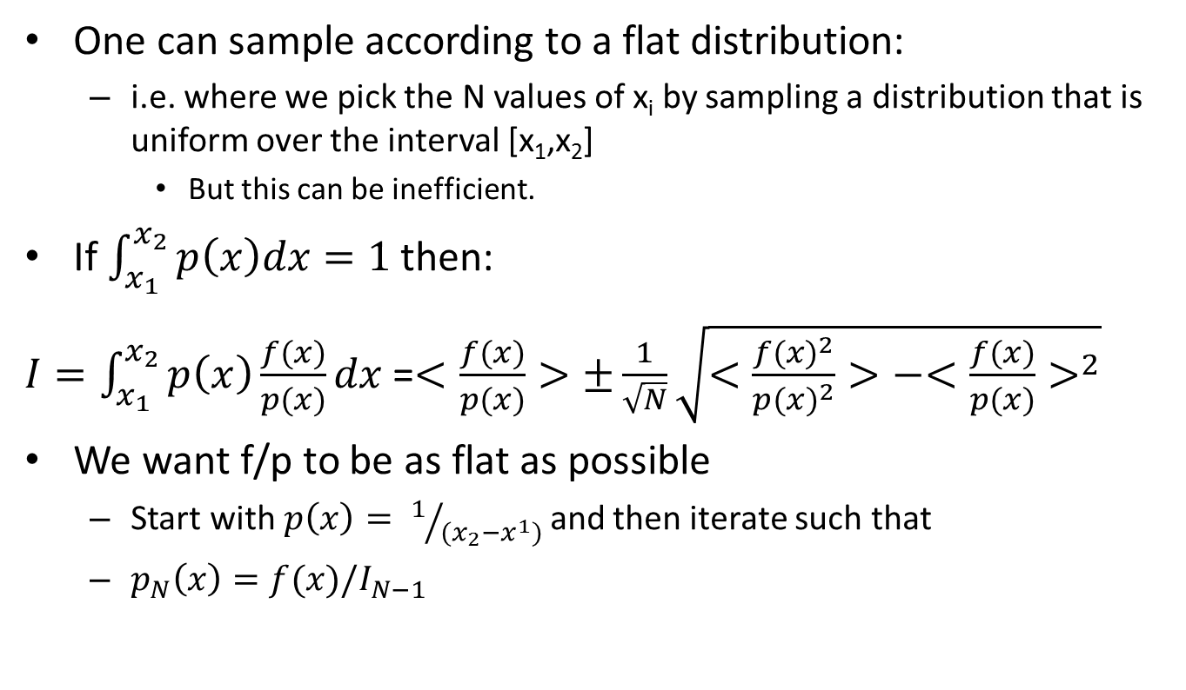
Monte Carlo Integration Basics
One can sample according to a flat distribution:
  i.e. where we pick the N values of x_{i} by sampling a distribution that is uniform over the interval [x₁,x₂]
    But this can be inefficient.
If then:
=
We want f/p to be as flat as possible
  Start with and then iterate such that

Slide 15
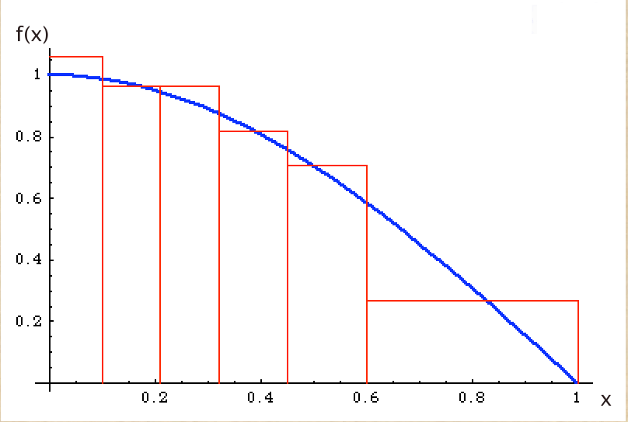
Vegas
The algorithm described on the previous page is implemented in the VEGAS integrator which is the primary engine in HEP, and has been for over 30 years.
Notes:
Adjusts step functions to estimate integrand.

Slide 16
Simple Event Generation
(for the matrix element)
Once one has a reliable estimate for the total integral we can ‘pick’ events based on the relative weights of the various kinematic configurations as follows (the hit or miss method):
  pick a random value of x
  If f(x) / f_{max} > R (a uniformly distributed random number in the interval [0,1]) keep the event
  Otherwise go back to 1
Notes:
There are more complicated ways to generate events – but this simple explanation illustrates the basic idea

Slide 17
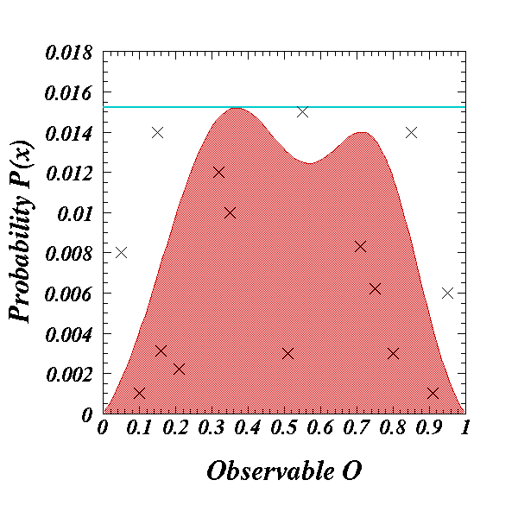
Simple event generation
S. Mrenna 2009 CTEQ Summer School

Slide 18
The Parton Shower
The outgoing states of the Hard scatter can emit radiation this is described by the parton shower.
This allows the number of final state particles to grow
  The decision about whether or not a final state particle radiates is made via a monte-carlo based decision algorithm until a pre-defined cut off.

Slide 19
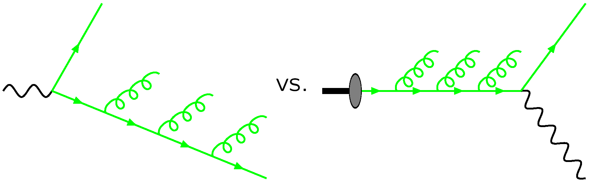
Inverse parton shower
A similar process occurs for the incoming partons.
  An inverse shower process is evaluated in order to arrive at the properties of the original parton in the proton which took part in the interaction.
M. Seymour,
MCnet-LPCC Summer School 2012

Slide 20
Matching
The hard scatter part of the event is generally a leading order process in perturbation theory.
The Parton Shower, and Inverse Parton Shower evolution of the event are only valid if they are not making large modifications to the event kinematics.
In order to properly describe events with additional particles in the final state which carry substantial momentum one needs to evaluate higher order processes.

Slide 21
Matching
The change from ‘soft’ emission to higher orders of perturbative theory is something that is derived from fits to the data
Events Generators have lots of tuning parameters

Slide 22
Initial State
We have explored the basic idea which takes us from a set of input partons from the incoming protons with well defined kinematic properties, to a well defined set of output partons. A description of the probability of finding the expected incoming partons in the proton is called the parton distribution function or PDF. There are a small number (under 10 that I am aware of) of groups which perform global fits to as much data as possible over a large energy range in order to paramaterise the PDF’s

Slide 23
Hadronisation / Final states
As the outgoing partons (if they are coloured objects i.e. quarks / gluons) leave the interaction point they will Hadronise
  Two basic approaches:
    Lund String Model (pythia)
    Cluster model (Herwig)
  Both take quarks / gluons as input and provide hadrons as output which then decay according to their branching fraction

Slide 24
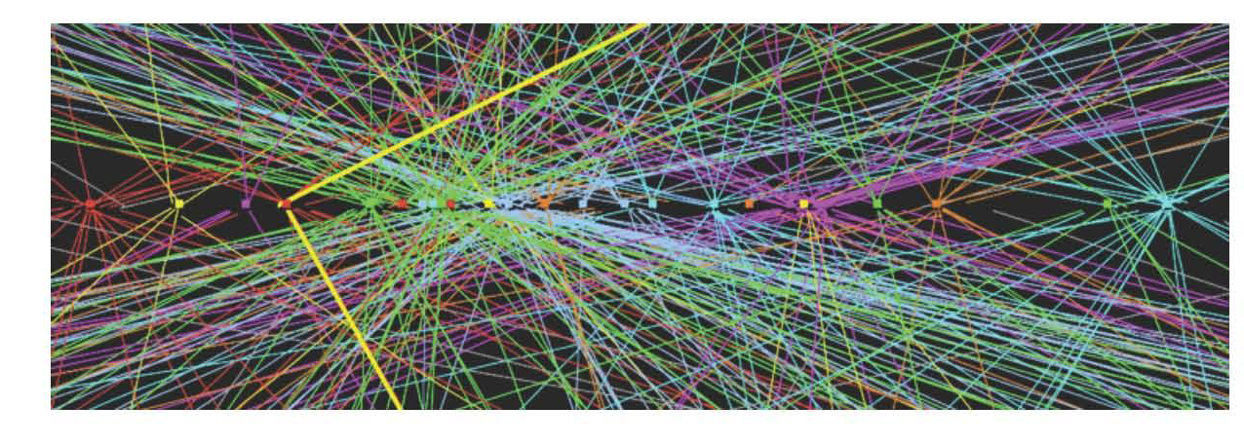
The rest of the event
Unfortunately even this (not really) simple picture does not yet leave us with something that can be compared directly to the data.
  The LHC collides bunches of protons at a time
  The effect of these other interactions need to be accurately modelled as well

Slide 25
Detector simulation
The propagation of the Final states through the detector is also a stochastic process, and is evaluated by taking small steps in distance and asking the question
  Has the particle deposited energy in the detector during this step
  This is a slow process and where most computing power is used for MC generation

Slide 26
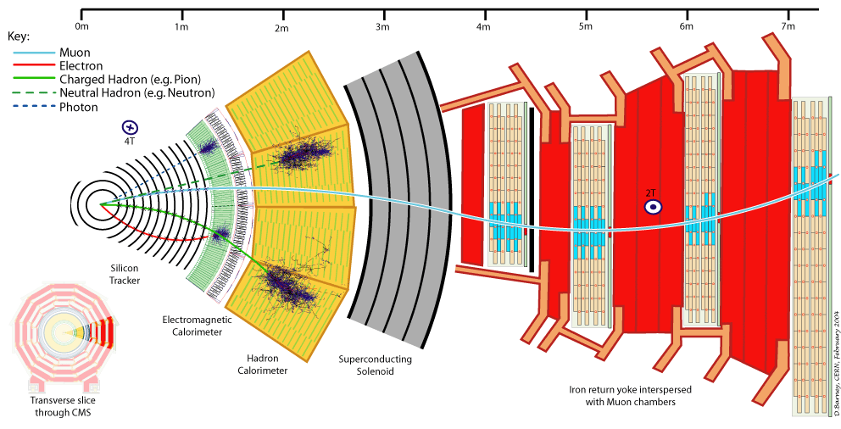
Particle Propogation

Slide 27
Summary
Monte-Carlo event generation is a complex, but important tool which allows for us to make comparisons between theoretical predictions and experimental data
An accurate Monte-Carlo event generator has to reproduce effects which are perturbatively calculable
and those which are phenomenologically motivated, and navigate the interface between these 2 regions

